Slide 1
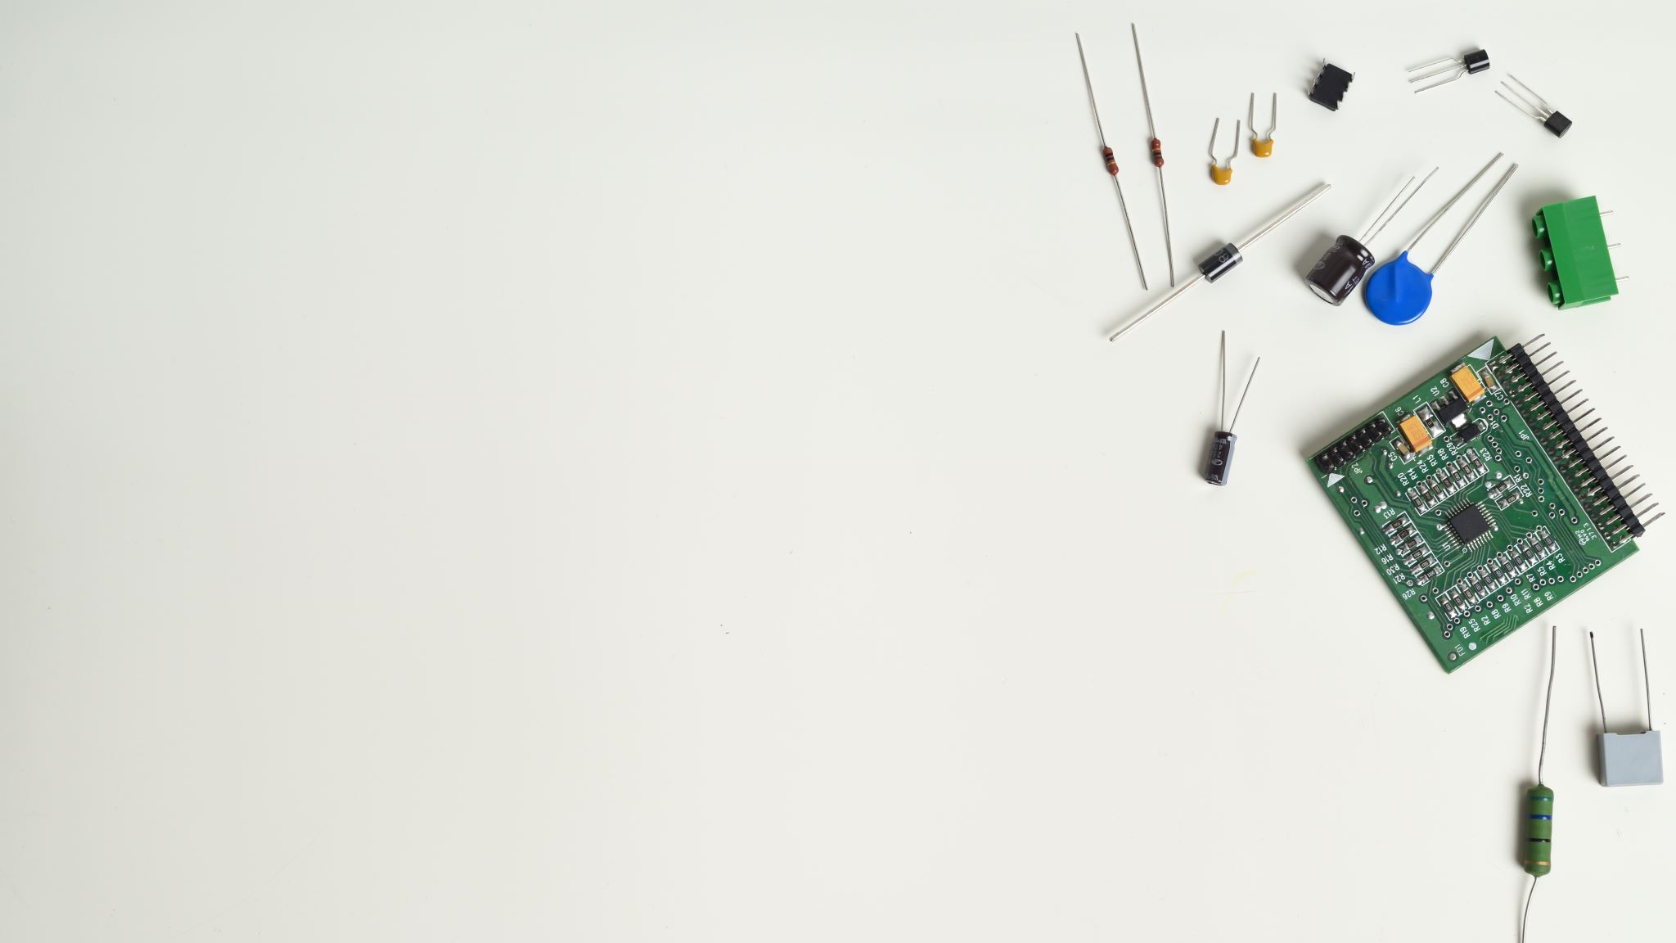
Smart Home Technology
By Matthew Cote, CEIS101 Final

Slide 2

Introduction
Developing and creating smart home technologies have a lot of hurtles that you must cross. I had to face them all and had to find solutions to each of these problems
•Designing the hardware layout and simulate it
•Build it and code it.
•Debug and test
•Optimize hardware and software.

Slide 3

Designing a Circuit in Tinkercad

Slide 4
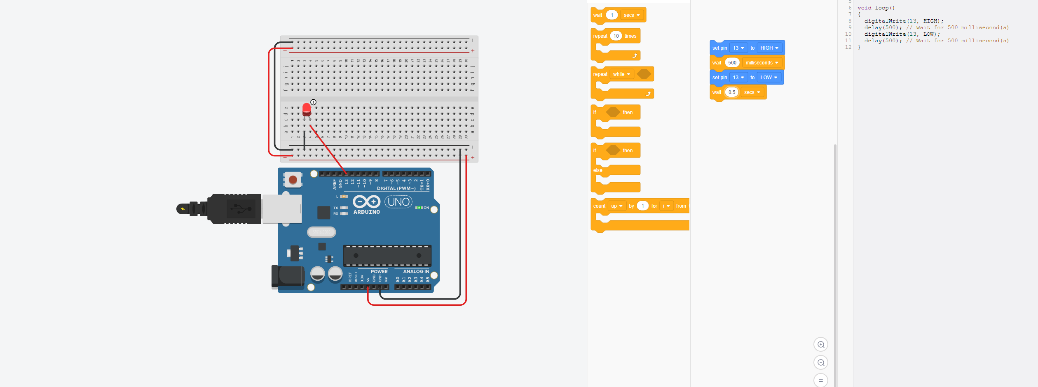
The Very Beginning
At the very beginning we started with basic circuits.

Slide 5
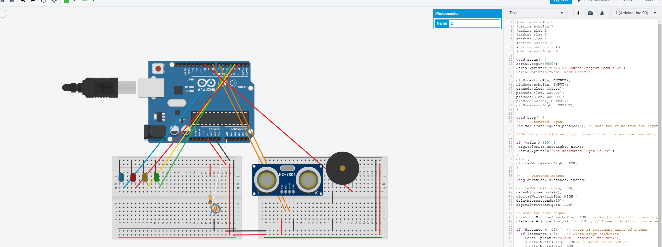
Further Designing
Then they became more complicated and sophisticated

Slide 6

Parts, Circuits, and components

Slide 7
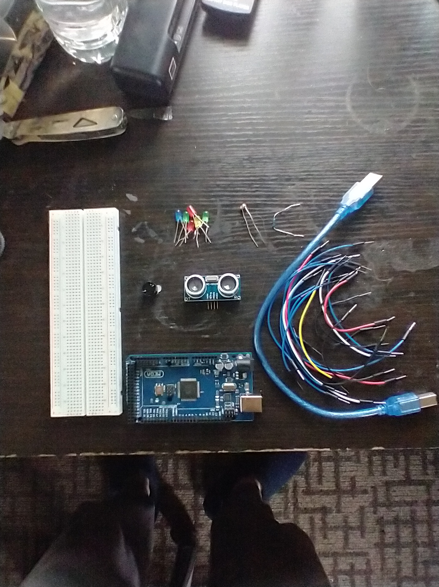
Components
Arduino Mega 2560
USB Type B to Type A Cable
Wire
Breadbord
Ultrasonic Sensor
Passive Buzzer
Photoresistor
LED’s
10k Resistor

Slide 8
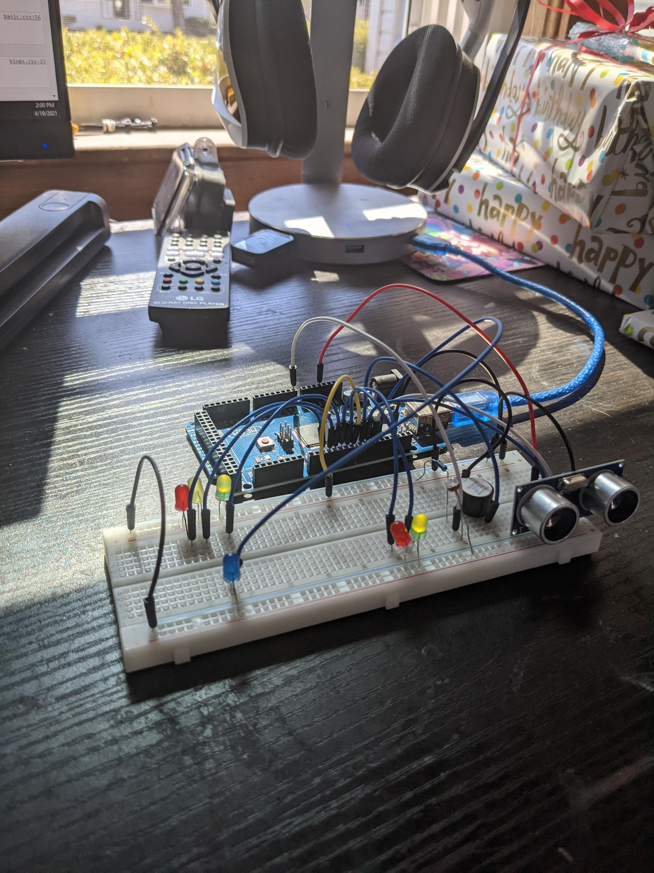
Completed Circuit (Picture)

Slide 9
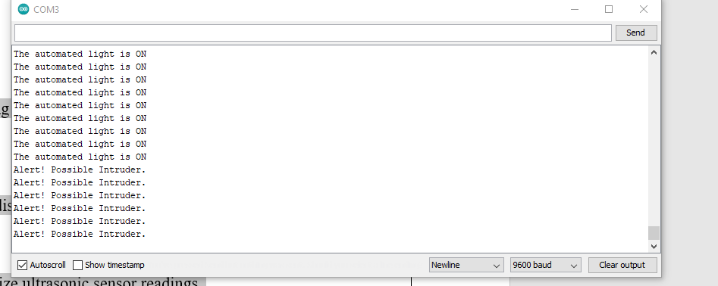
Serial Monitor during Testing (Screenshot)

Slide 10

Adding the door sensor

Slide 11
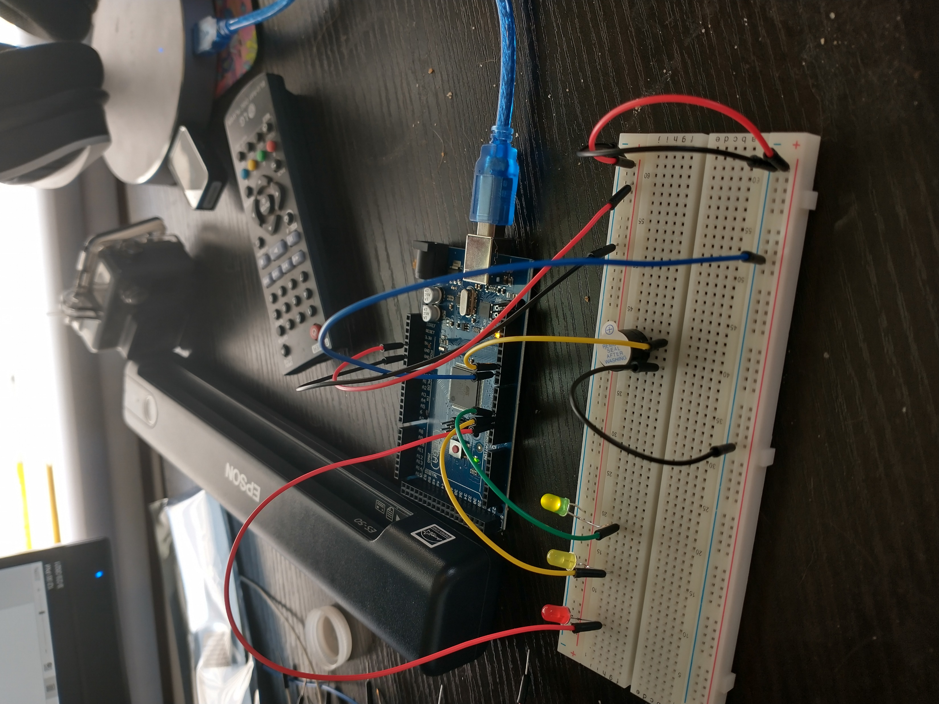
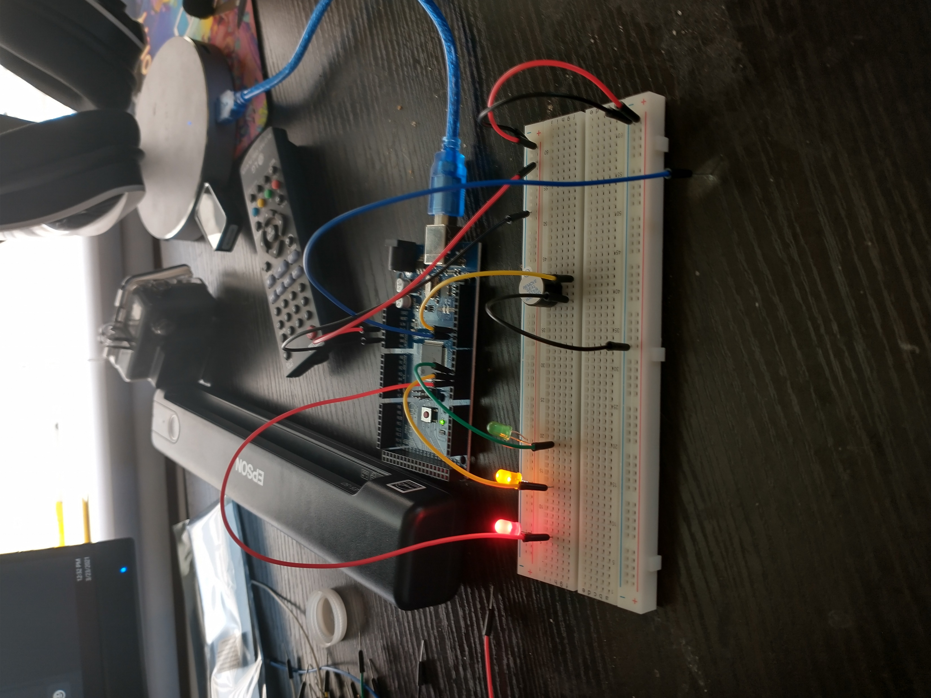
The Circuit when open and closed(Picture)
Door Closed
Door Open

Slide 12
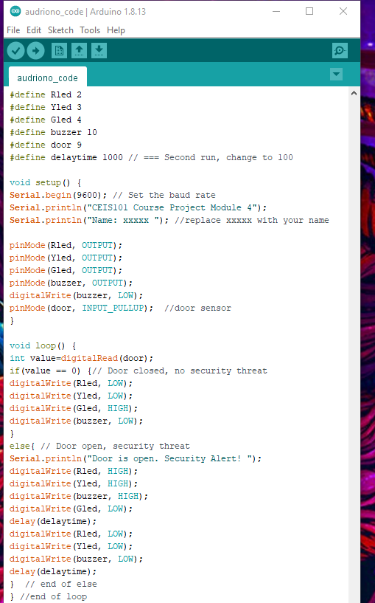
Code (Screenshot)

Slide 13

Creating and adding the motion detection device

Slide 14

Circuit with Green LED On (Picture)

Slide 15
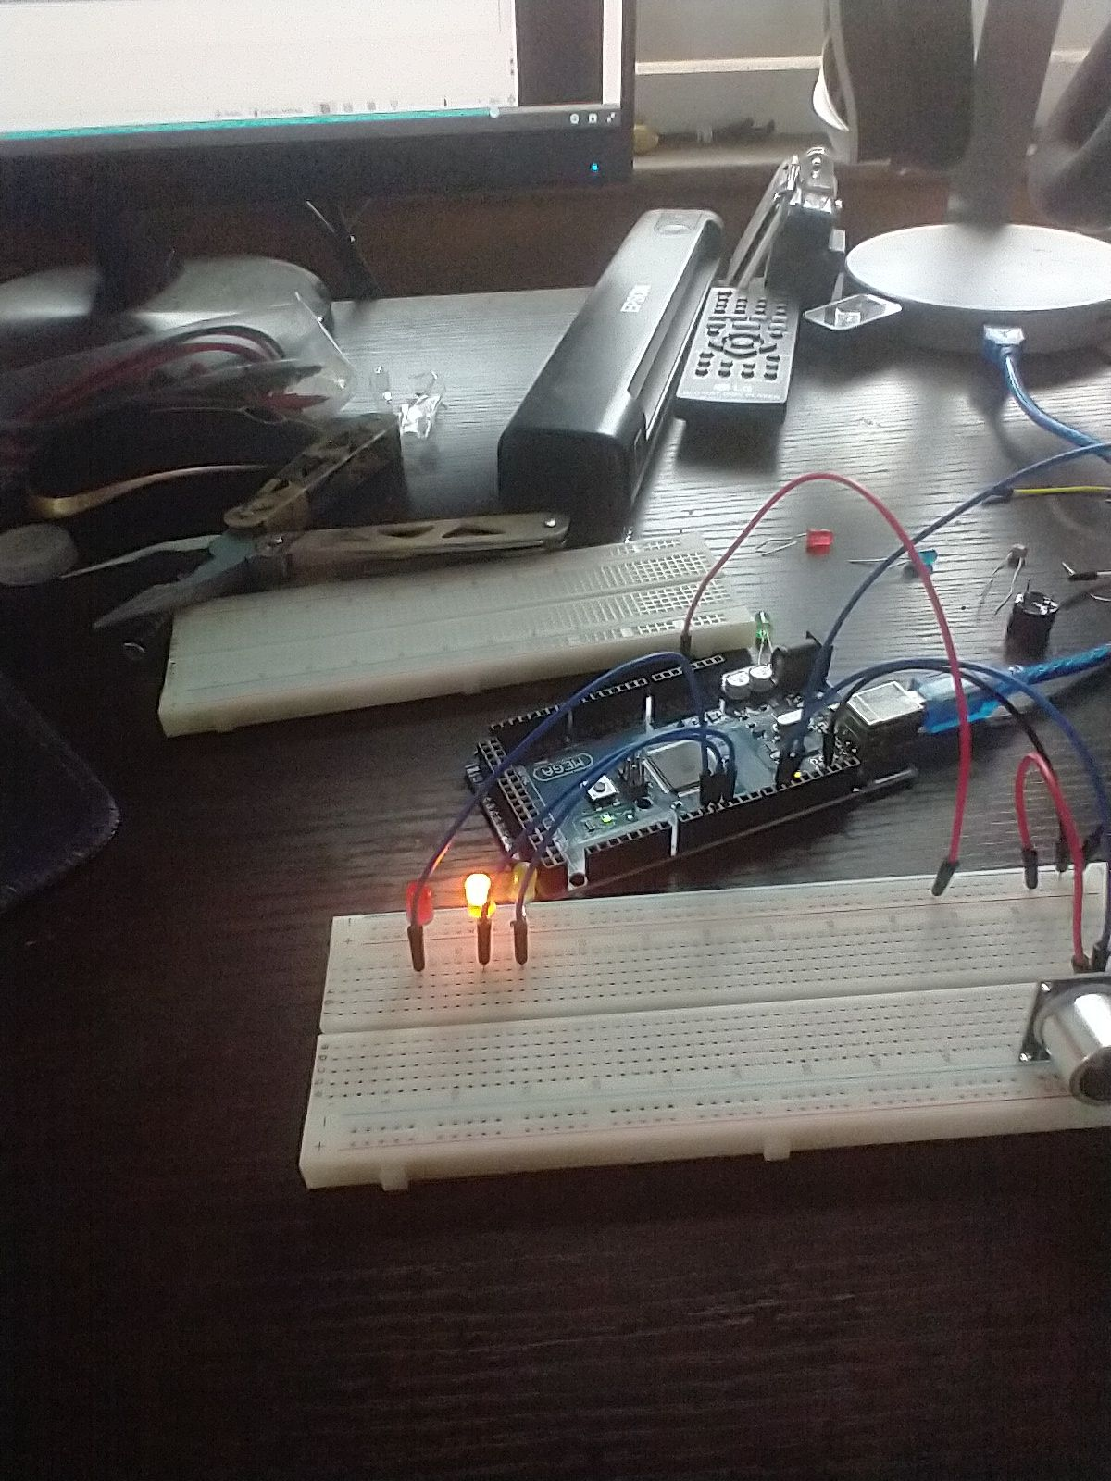
Circuit with Yellow LED On (Picture)

Slide 16
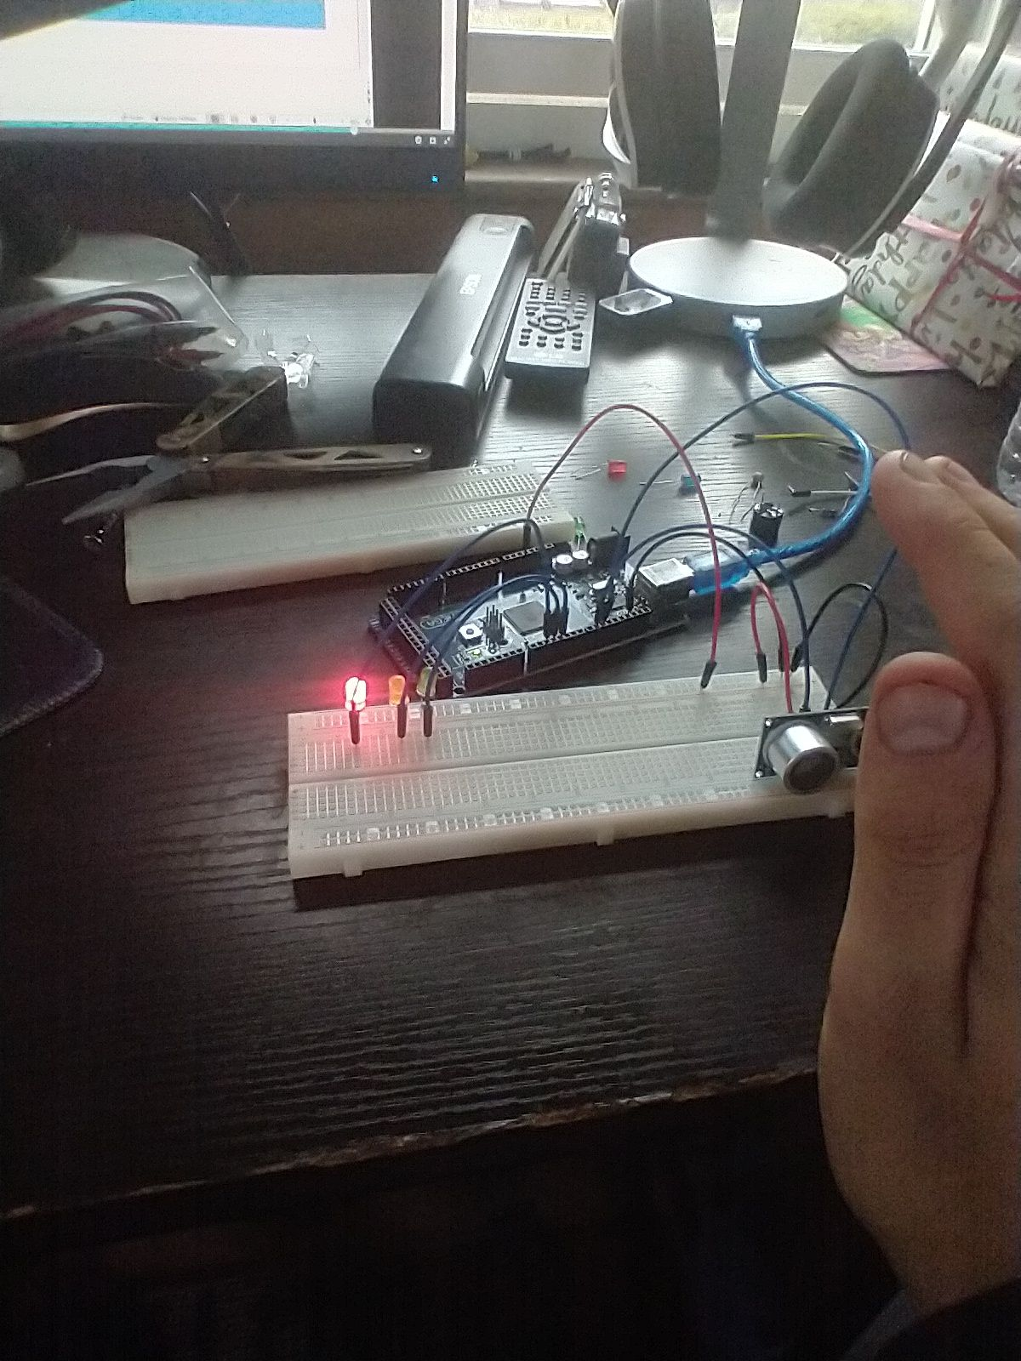
Circuit with Red LED On (Picture)

Slide 17
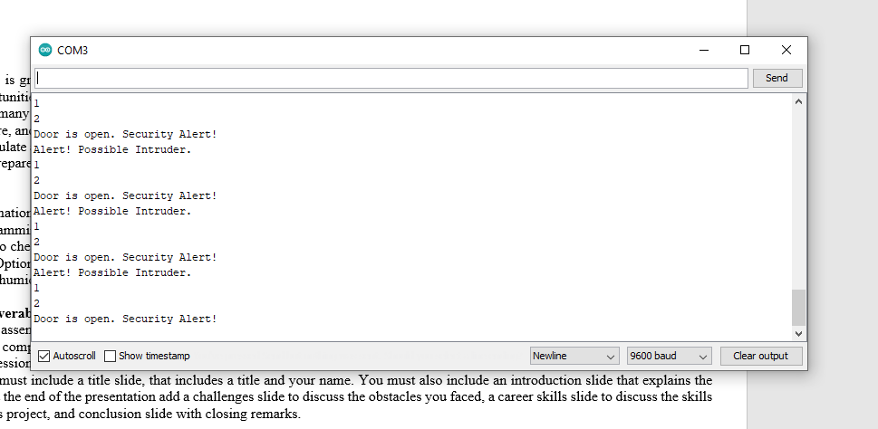
Serial Monitor (Screenshot)
2 is the distance in inches
Ignore the number 1

Slide 18
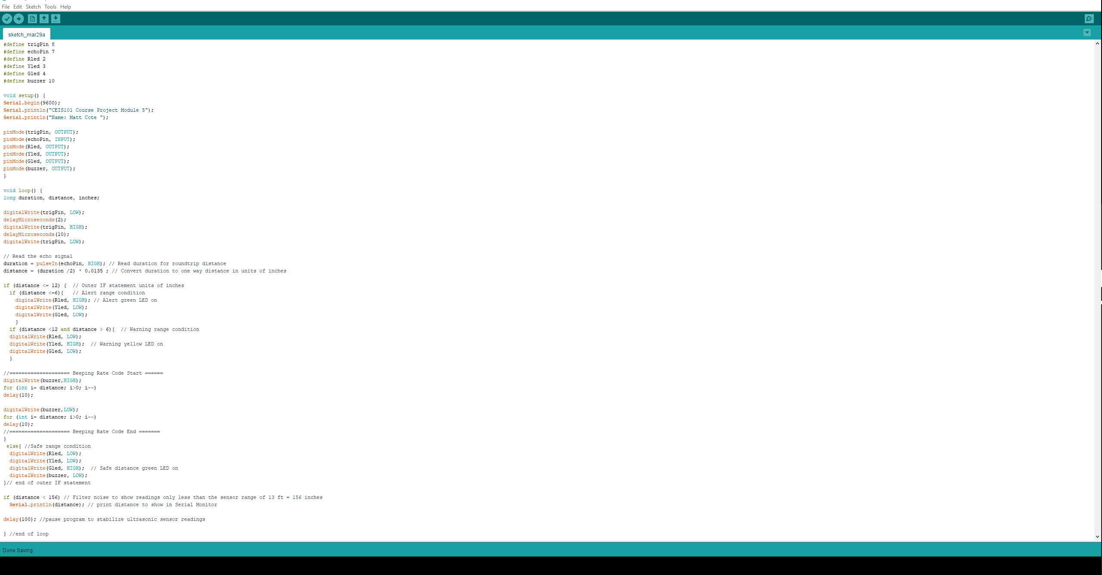
Code from the Arduino

Slide 19
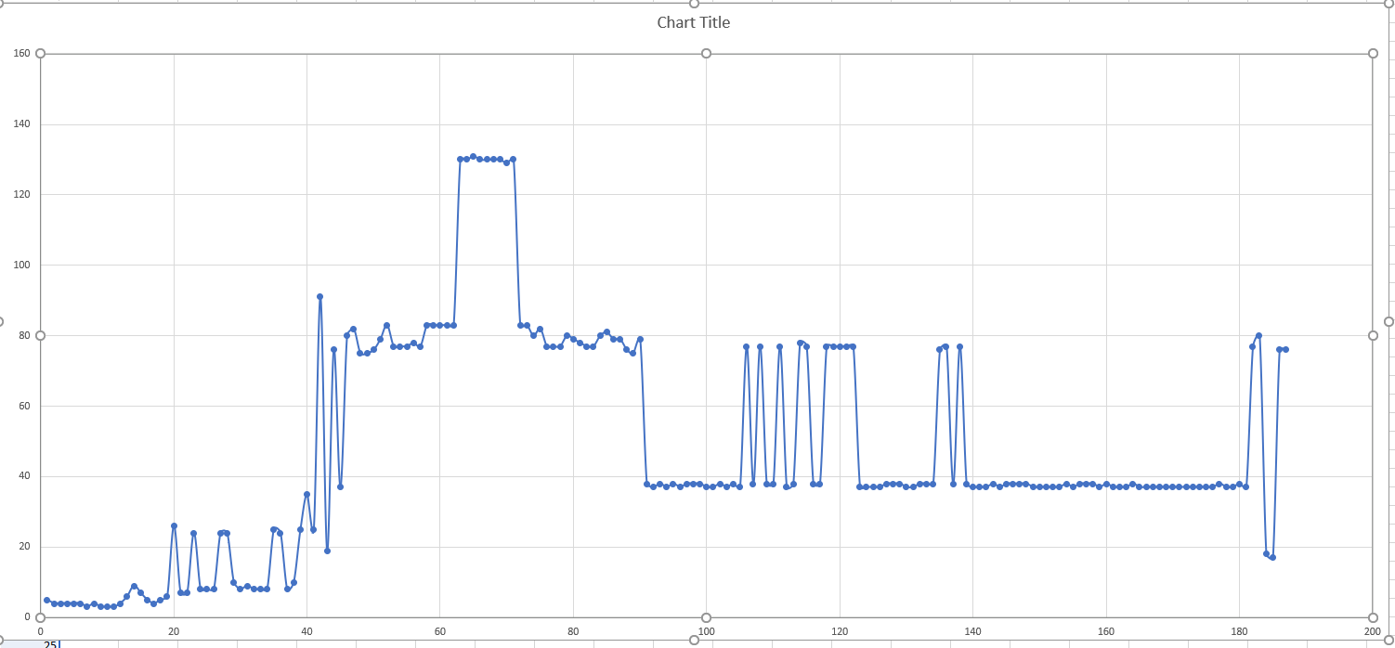
Plot of data from the Ultrasonic Sensor (Graph from Excel)

Slide 20

Adding a Light Sensor

Slide 21
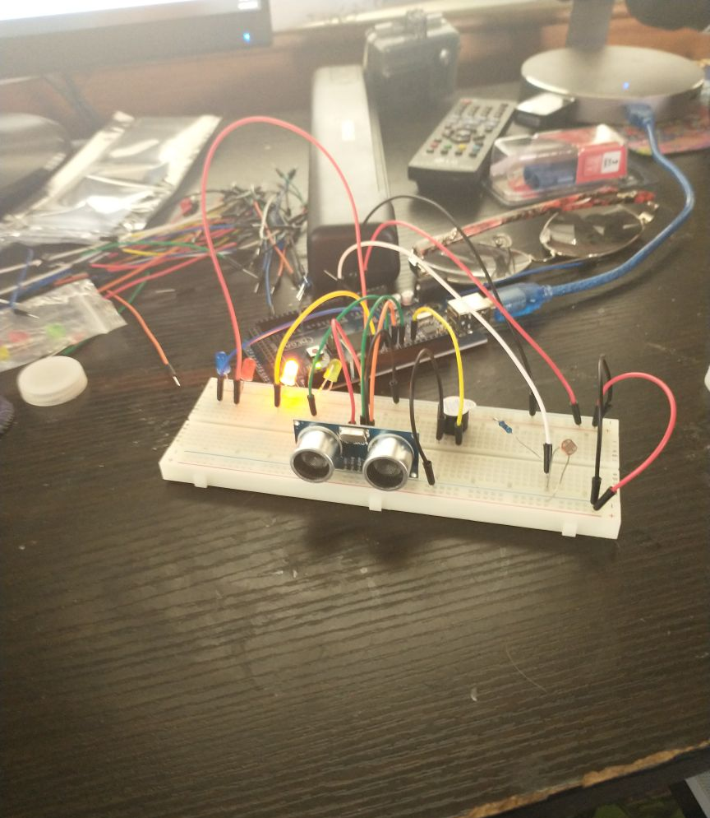
Circuit with Light Sensor Blue LED Off (Picture)

Slide 22
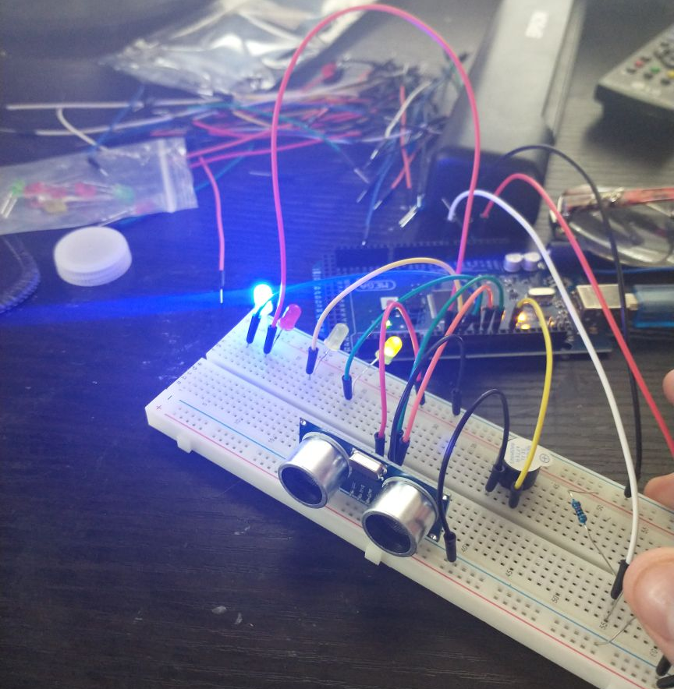
Circuit with the Blue LED On (Picture)

Slide 23
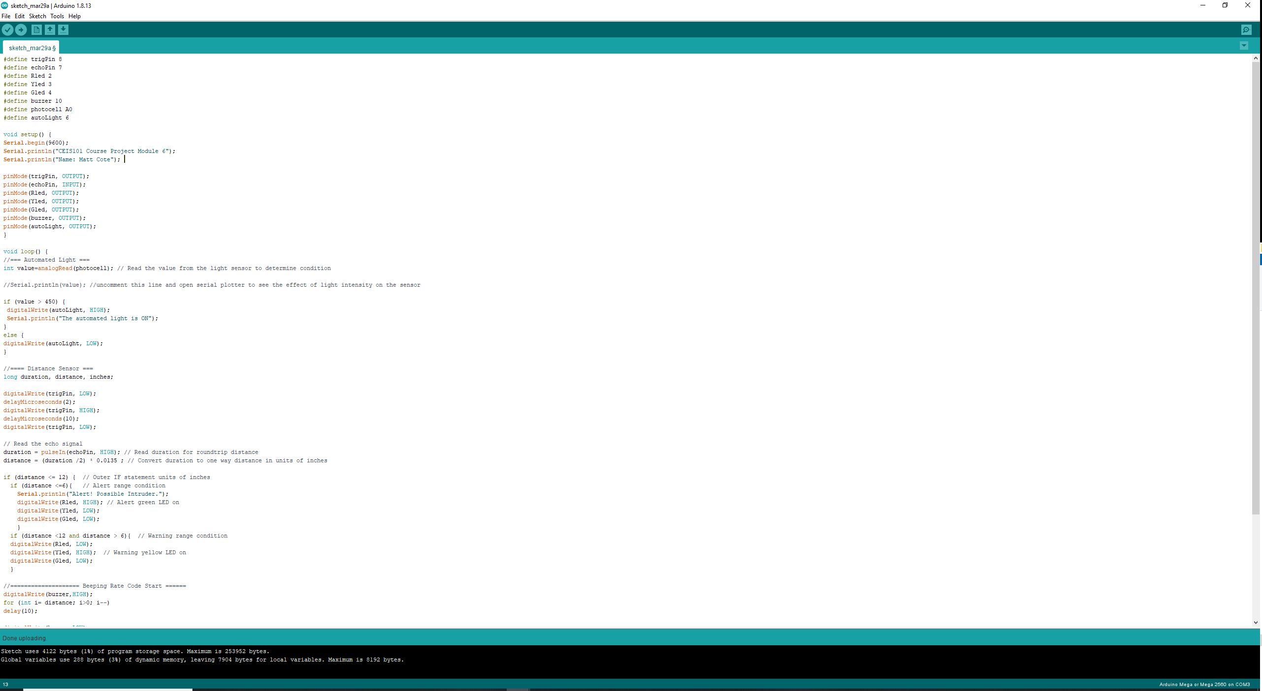
Arduino Code (Screenshot)

Slide 24
Serial Monitor during Testing (Screenshot)

Slide 25
Challanges
Threw out this project I did have one major issue. So during the testing phase, I was not able to get the door sensor to work at all on the positive rail which puzzles me. I was able to get it to work properly if all other components were separately powered and the rail was left unpowered. I later found out that one of my pins on my Arduino was dead after testing other things that I knew worked on that pin.

Slide 26
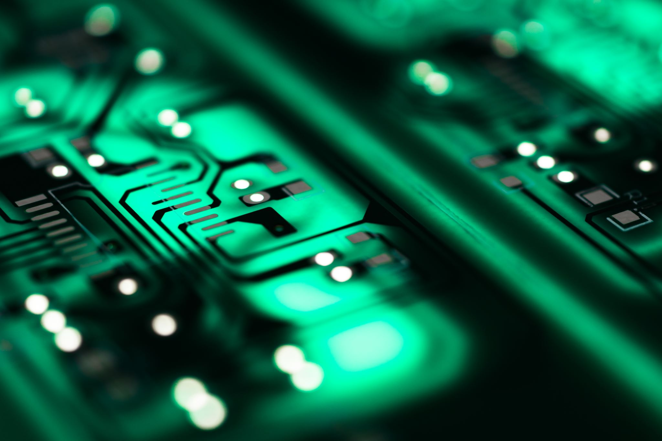
Career Skills Acquired
Circuit Troubleshooting
A solid understanding of C++
Design/CAD
Fundamentals of Electricity

Slide 27

Conclusions
This project and class were very informative. Before this class, my skills with different forms of programming were very limited. Now I have a good understanding of C++ from the projects and HTML/CSS from the website I built to send this presentation from. I did have the hardware skills before this but there was a lot I learn from that
I would recommend this class to anyone who already has IT skills and is looking to improve. There's something for everyone.

